Slide 1




Slide 2


Mohamed Islam Boumendjel
MERN stack web developer
GDG dev team memeber
3rd year student at ESI Algiers
Email:jm_boumendjel@esi.dz discord id: islam#7299

Slide 3
Node.js

Slide 4
Node.js
Modules
REST APIs
Express.js

Slide 5


What is Node.js ?
Node.js is a cross-platform and open source asynchronous JavaScript runtime environment built on Chrome’s V8 JavaScript engine.

Slide 6
Differenece between JavaScript running on browser and node.js
Browser
- Run on browser
- Used for front-end development
- Global object: window
- Has no access to filesystem
- Has access to DOM
Node.js
- Run outside the browser
- Used generally for backend-development
- Global object: global
- Has access to filesystem
- Has no access to DOM

Slide 7
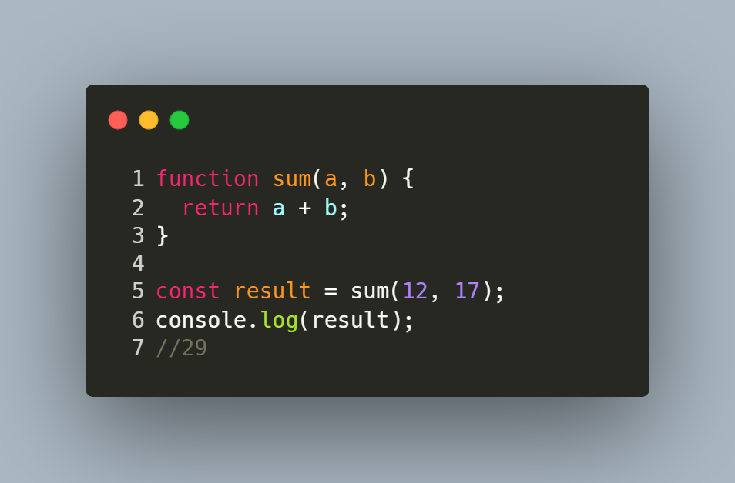
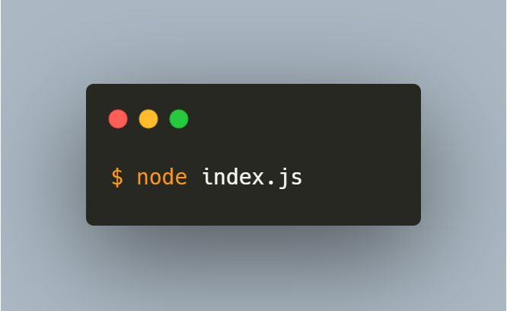
Example

Slide 8
Modules
- A module is a JavaScript library.
- It contains variables, classes and functions.
- There are 3 types of modules:
- Built-in modules
- Custom modules
- Npm packages

Slide 9
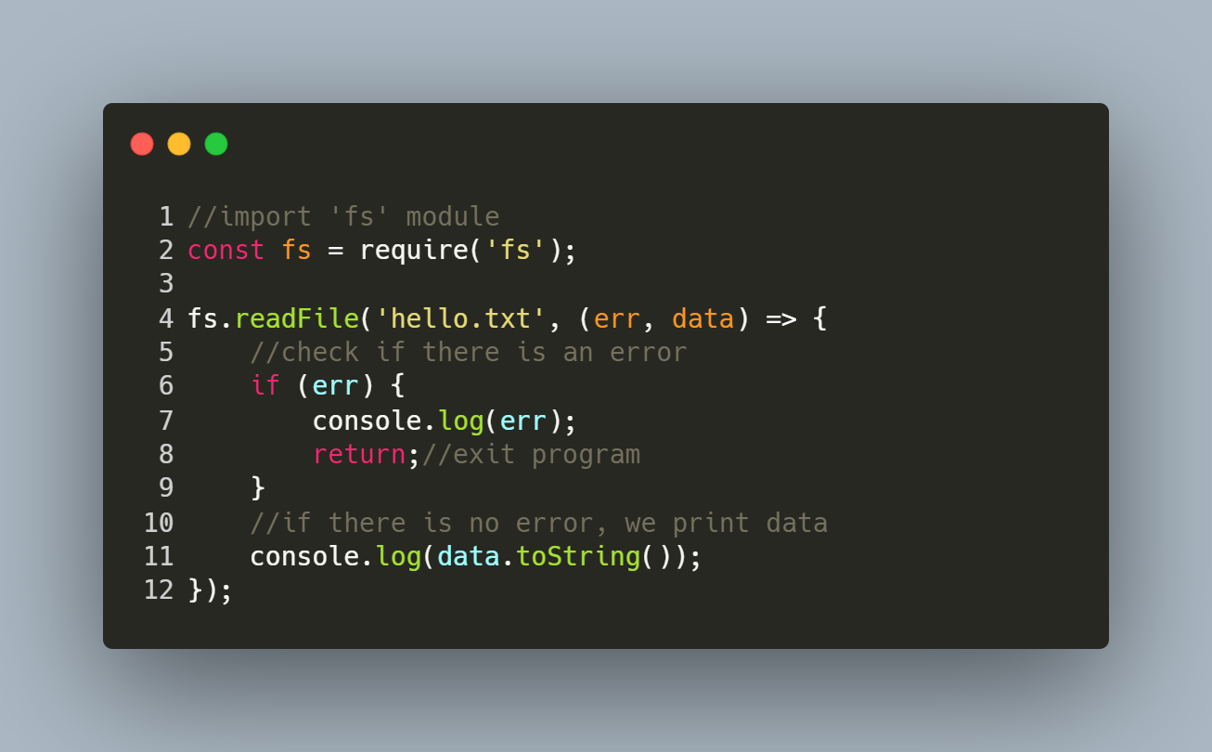
Built-in modules

Slide 10
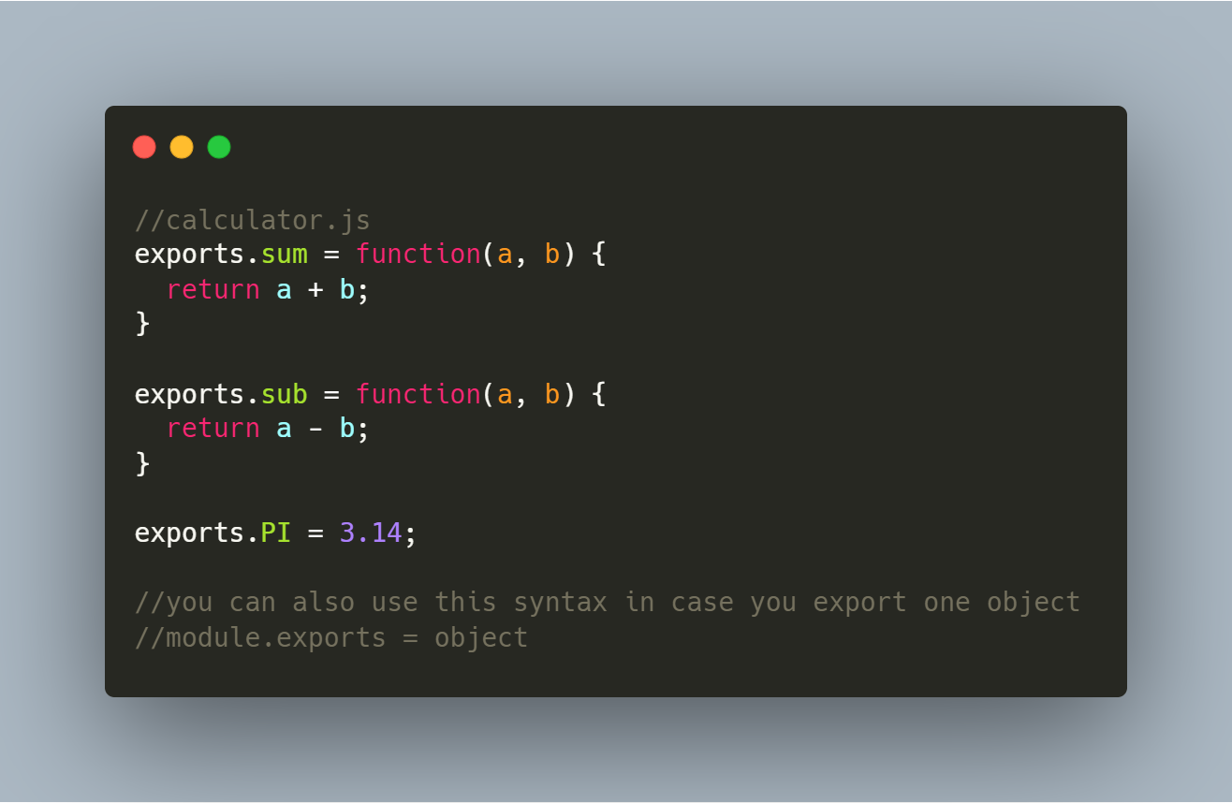
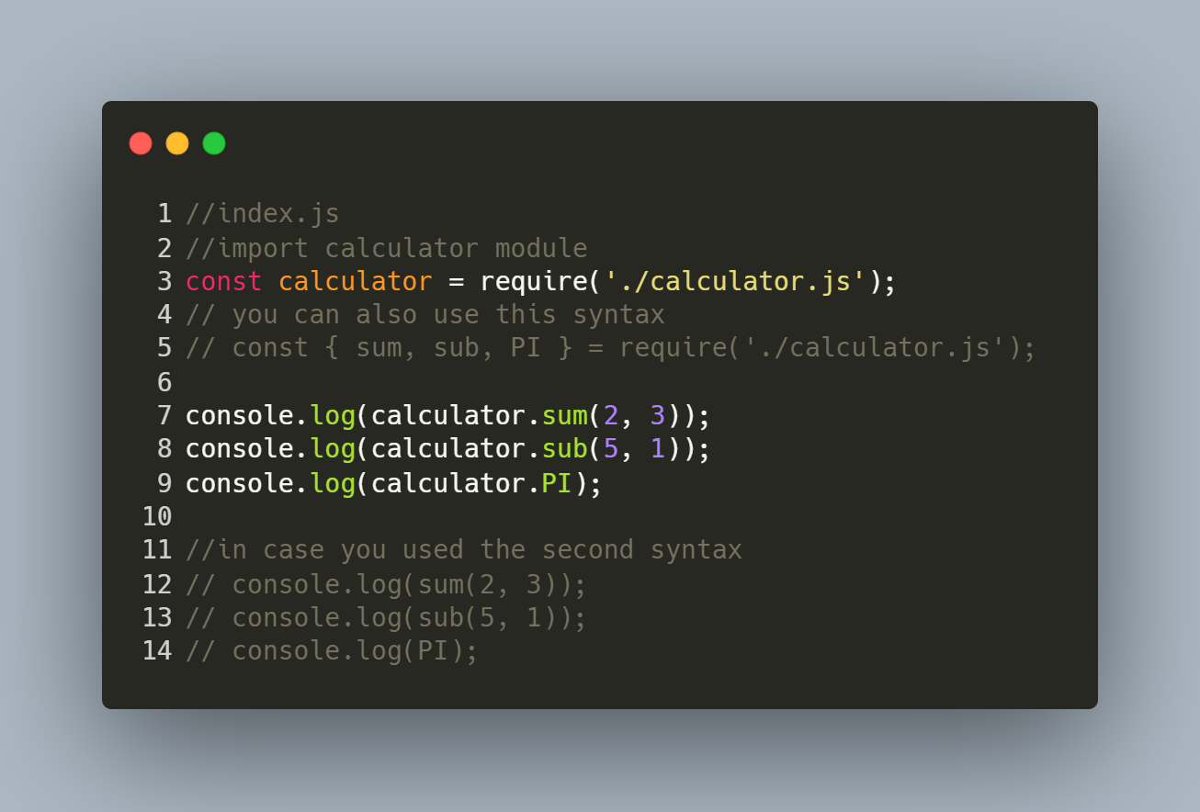
custom modules

Slide 11
Npm packages
- Npm stands for ‘‘Node Package Manager’’
- Custom modules built by other developers and available to install
- https://www.npmjs.com/

Slide 12
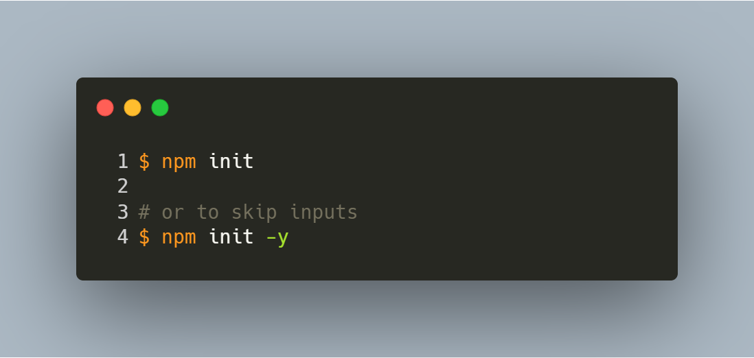
Initialising node.js project

Slide 13
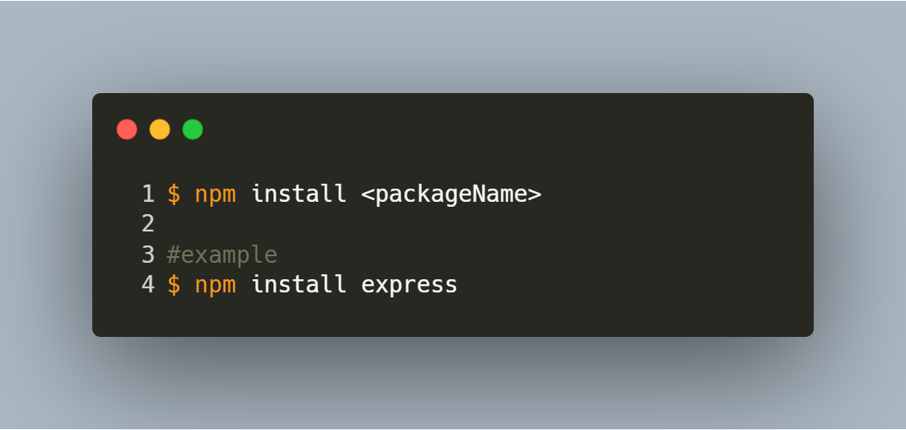
Installing packages

Slide 14
REST APIs

Slide 15
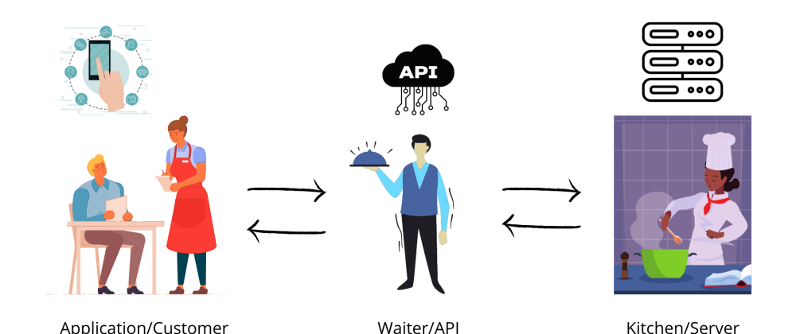
API
- API stands for Application Programming Interface
- An interface that offer services to other software

Slide 16
REST API
- REST stands for “Representational State Transfer”
- A REST API (or RESTful API) is an API that uses HTTP requests to access and use data
- Client and server decoupling
- Uses JSON
- Can be layered
- Uniform interface (same request => same result)

Slide 17
HTTP methods
Method | use
GET | Retreive data (read)
POST | Create new entit
PUT | update an entity
DELETE | Delete an entity

Slide 18
HTTP status codes
Each HTTP response from the server has a HTTP code that represent its status.
1XX : information
2XX: success
3XX: redirection
4XX: client error
5XX: server error
More details: https://developer.mozilla.org/en-US/docs/Web/HTTP/Status

Slide 19
Common HTTP status codes
code | meaning
200 | OK
201 | Created
400 | Bad request
401 | unauthorized
402 | forbidden
404 | Not found
500 | Internal server error

Slide 20
ExpressJS

Slide 21

ExpressJS
Fast, unopinionated, minimalist web framework for Node.js
Flexible
Performance
Many other frameworks are built on top of it

Slide 22
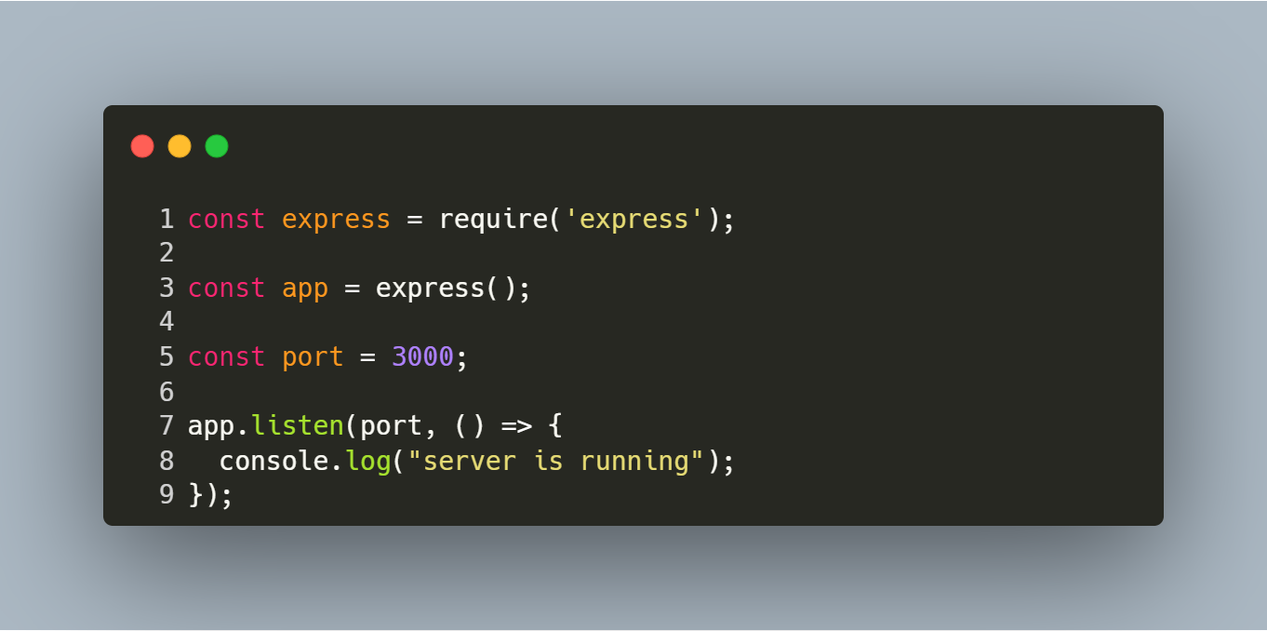
Initialising the app

Slide 23
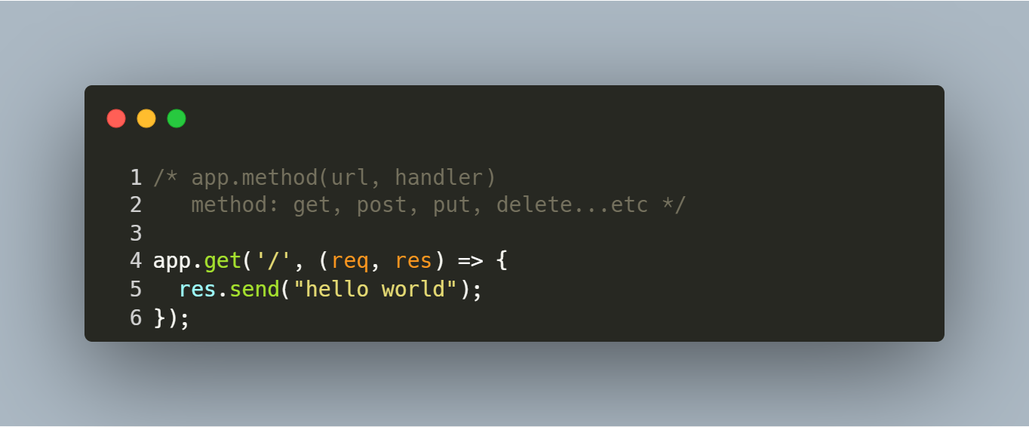
routing

Slide 24
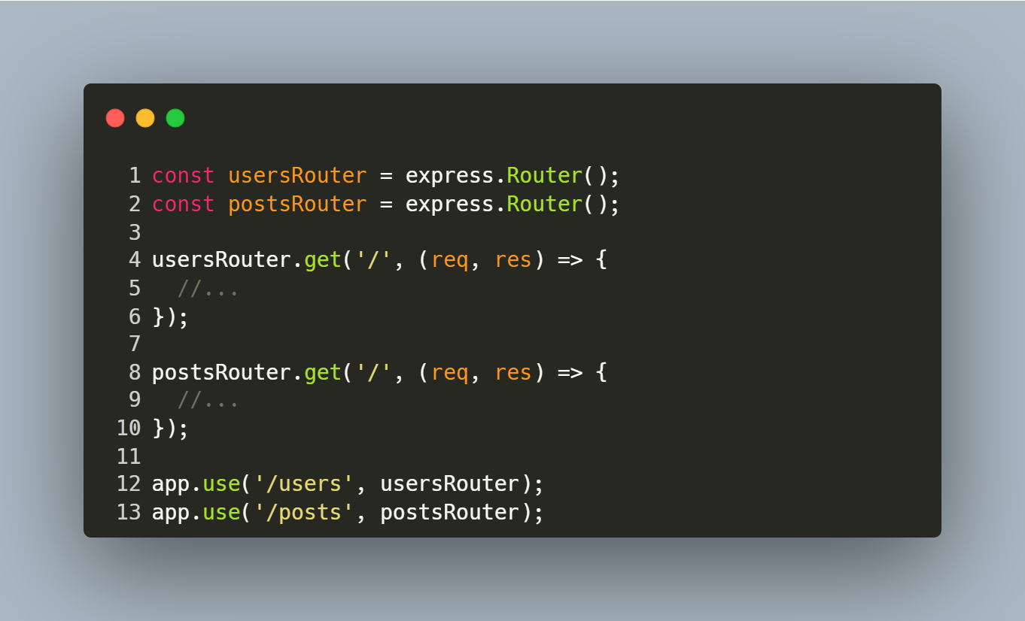
routing

Slide 25
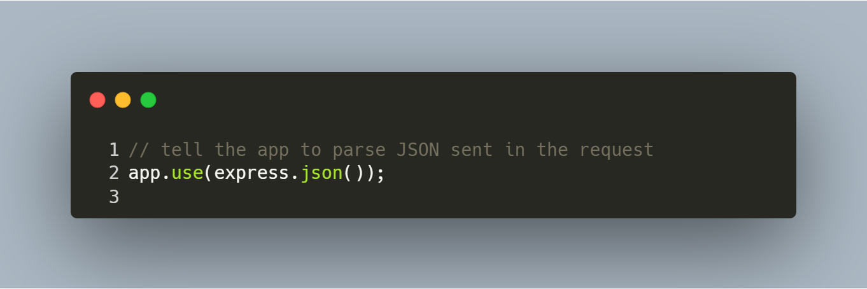
Body parser

Slide 26
Request object
- req.body: an object containing the data sent with the request
- req.ip: remote ip address of the request
- req.method: http method used for the request
- req.headers: an object containing the headers of the request
- req.params: an object containing route parameters ex: /users/:id => req.params.id

Slide 27
Response object
- res.send(data): send a response with data, data can be object, string, buffer.
- res.sendFile(path, options): send a file
- res.json(data): send a response with data as JSON
- res.status(code): set the response HTTP status code
- res.redirect(url): redirect the request to another URL
- res.set(headerName, value): set headerName to value
- res.end(): end response

Slide 28
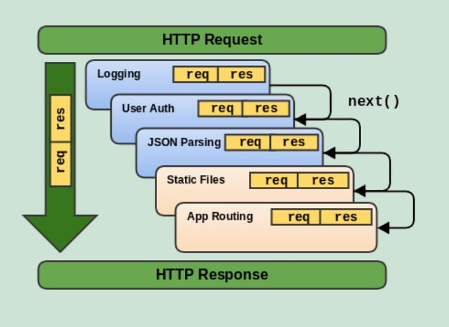
middleware

Slide 29
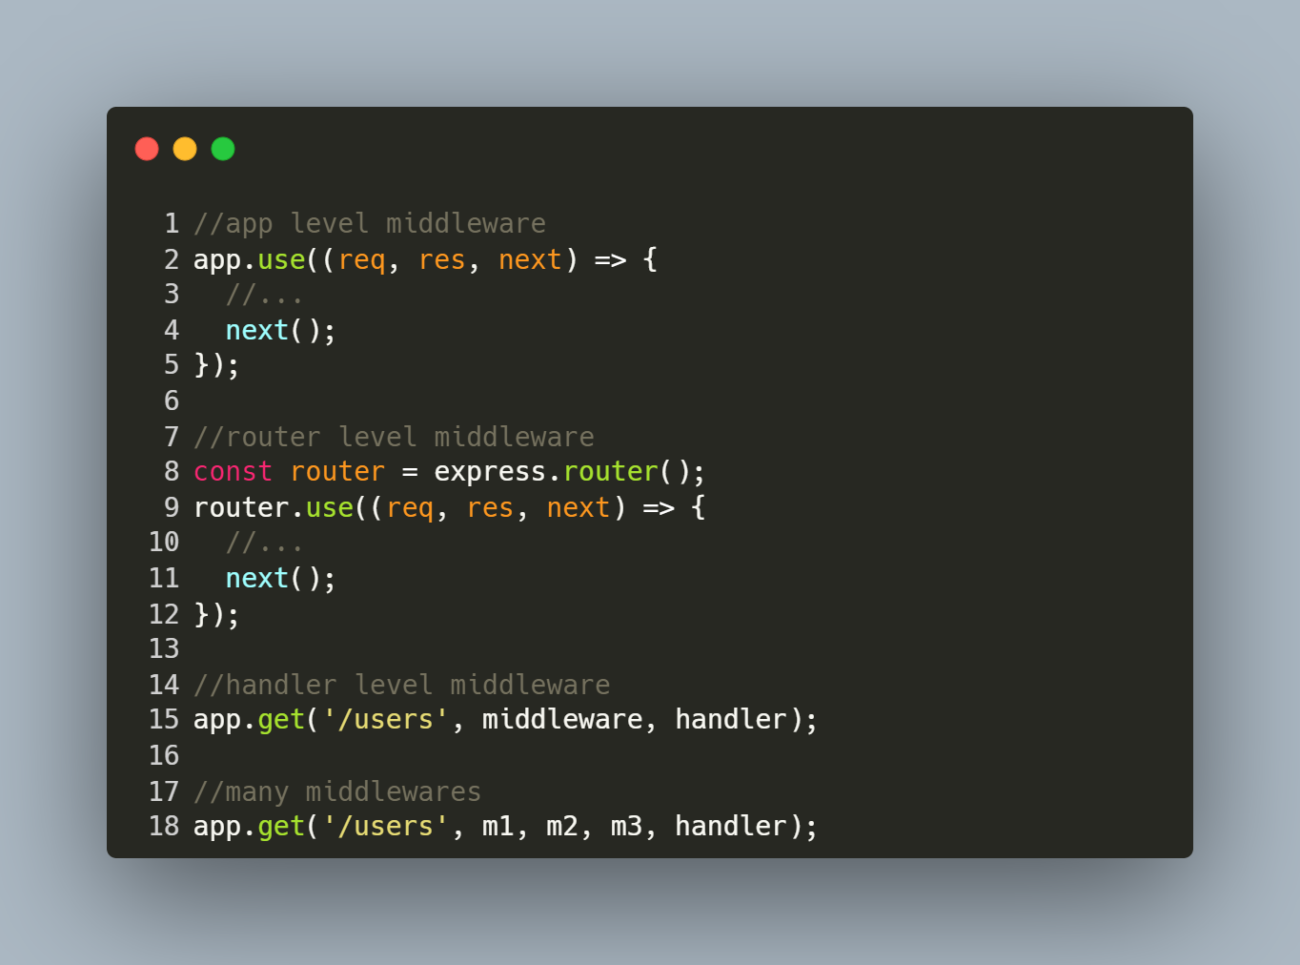
middleware

Slide 30
Resources
https://nodejs.org/en/docs/
https://www.w3schools.com/nodejs/default.asp
https://www.restapitutorial.com
https://expressjs.com/
https://www.youtube.com/watch?v=-0exw-9YJBo

Slide 31
Thank you for your kind attention!

